Slide 1
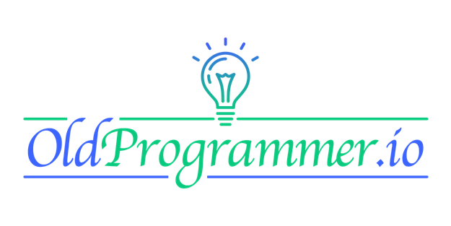

CARE
An pragmatic approach to application architecture.
The best architecture is the one that YOU can easily understand, explain to others and rapidly iterate over new features with minimal code refactoring.
These materials are provided under the terms of the MIT license and are free to adapt and use. There is no warranty express or implied.

Slide 2
WHAT IS THE CARE ACRONYM?
C - Consistent approach to application development.
A – Agnostic, as in technology agnostic.
R - Rapid Development.
E – Efficient development, efficient code.

Slide 3
CARE
WHAT IS CARE ALL ABOUT?
CARE is a guideline that will assist in the rapid development of software that is consistent and efficient, regardless of Platform.
CARE provides compromises with respect to community defined best practices. These compromises allow us to achieve efficiency, consistency, and effectiveness in our software development environment.
CARE is technology agnostic. The guidelines are valid no matter what the platform is. iOS, Android, .NET, etc.
CARE is a way to inform and guide the evolution of software projects.
CARE rules are NOT absolute.

Slide 4
CARE
CONCEPTS ARE THE FOUNDATION OF CARE
Concepts are few by design. Less is more. More concepts, more confusion.
Concepts are focused on providing an architectural foundation for rapidly building applications, in a platform agnostic way.
There should be reason for a concept to exist and one should think of the effort necessary to properly introduce a new concept. Introducing a new concept should include documenting, designing, design review, implementing code, code review, and testing code. This indirectly defines cost to introduce a new concept and like many things will compared with respect to its cost/value.
The concepts described herein should be common knowledge and gospel to an IPS Software Engineer. These concepts will be the basis of each project. However, each project will build and adapt these concepts as needed.
The discipline of identifying, justifying, and establishing a concept is a good practice.

Slide 5
CARE
CARE Overview
CARE puts an emphasis on pattern oriented software development with Single Responsibility Principal as a valued attribute. PubSub, Dependency Injection, Views, ViewModels, Services, Repositories, and Models represent primary nomenclature
CARE provides for less coupling between components with fewer interdependencies across the application.
The architectural model is lean, with a focus on simplicity and understanding with some relaxation of object oriented purity.
Architecture lends itself towards a functional style of programming, which would mitigate the divergence from pure object orientation (not required, per-se).
CARE is consistency with well defined requirements with respect to cross-cutting concerns such as configuration and logging.
New projects start from a CAREfully implemented seed project. CARE code is forked from a seed project. CARE code is not common libraries. CARE code does not need to be concerned with backwards compatibility with other/older projects.

Slide 6
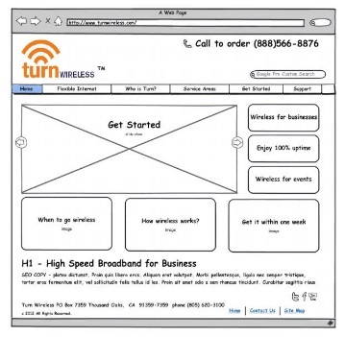
CARE
CAREfully oriented application
Static class to drive application initialization.
AppInfo will determine and expose common directories.
AppInfo will expose a configured PubSub.
Ioc is the Dependency Injection Container, effectively a high value replacement for the ‘new’ operator.
{name}View
MVVM – Model View, View Model
Prefer data binding.
Code should not directly reference visual controls.
AppInfo
ConfigDir_App
ConfigDir_AppData
SourceDir
PubSub
Ioc
SettingsManager
PubSub
Subscribe(…)
Unsubscribe(..)
Databinding
SettingsManager
GetValue<type>(settingId)
SetValue(settingId, value)
{name}ViewModel
{named}Service(s)
IOC - Dependency Injection
ResolveByType<type>()
ResolveById<type>(objectId)
{name}Service(s)
{named}Repository(s)
Logging Configuration
Freestanding Services
Activity is generally driven by PubSub.
Configured as Freestanding and instantiated during bootstrap process.
Configuration and lifecycle driven by Dependency Injection.
Traditional object model.
Awkward to acquire a reference from a completely different part of the application. Common solutions tends to over-use of singletons.
PubSub is the recommended solution.

Slide 7
CARE
AppInfo - Details
AppInfo
Static class to drive basic application initialization.
Exposes common application features like pubsub.
Exposes properties for common directory locations.
Evaluates and makes distinctions between development and release modes.
Bootstraps core services
Log Configuration
IOC Container Configuration
SettingsManager
Procedure to determine and expose standard directories. Values will vary;
Depending upon if running from source tree
Debug or Release Model
64bit or 32 Bit.
Potentially will include application specific directories.
public
ConfigDir_App (configuration files that don’t change based upon installation)
ConfigDir_AppData (configuration files that DO change based on the specific installation).
SourceDir (Provides source root, if running from SourceTree)
AppInfo will new up and call specifically focused configurators and bootstrap services.
In and off itself, AppInfo does not contain code to bootstrap other services.
AppInfo will maintain Single Responsibility.
public
PubSub
Subscribe(…)
Publish(…)
Unsubscribe(…)
General Purpose, Cross-Cutting, Application Services
Bootstraps and configurators called via AppInfo
Exposed as a static property by AppInfo.
Works like a Singleton, but not these services are NOT implemented as Singleton to better support testability.
public
Ioc (Inversion of Control Container)
ResolveByType<type>()
ResolveById(objectId)
public
SettingsManager
GetValue<type>(settingId)
SetValue(settingId,object)

Slide 8
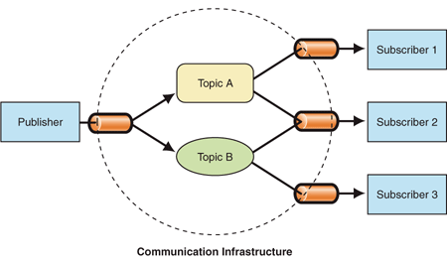
CARE
PubSub – Publish/Subscribe, Defined
In software architecture, publish–subscribe is a messaging pattern where senders of messages, called publishers, do not program the messages to be sent directly to specific receivers, called subscribers, but instead characterize published messages into classes without knowledge of which subscribers, if any, there may be. Similarly, subscribers express interest in one or more classes and only receive messages that are of interest, without knowledge of which publishers, if any, there are. [Wikipedia]
Publishers and Subscribers have no specific knowledge of each other.
Source: https://msdn.microsoft.com/en-us/library/ff649664.aspx
The Pub Sub as described is a simple, in-process pattern, inspired by Microsoft Patterns and Practice’s Event Aggregator from the Prism Framework.
Prism’s EventAggregator is oriented towards a UI context, would need adaption for application wide usage, and has issues that would need to be fixed.
The Patterns and Practice group is effectively no longer in existence.
In a simple context, like this, it’s simple pattern, simple to implement.

Slide 9
CARE
Dependency Injection
The IOC Container or Container refers to the software component that is configured and is used to instantiate object hierarchies (dependency graphs).
In simple terms, an IOC Container replaces “new”.
There are many open source options available for selecting a Dependency Injection Container. In .net, AutoFac is recommended. In HTML5, Angular2 has an easy to understand and easy to use Dependency Injection framework.
Dependency injection is a software design pattern that implements inversion of control for resolving dependencies.
Dependency injection is a technique that helps to keep a class focused on a singular purpose.
Dependency injection enables and focuses design on de-coupled components, with the result being an object model that is approachable with respect to unit testing.
Resolving a classes' dependencies is delegated to the IOC container.
This is a good reference for Dependency Injection
AppInfo
This is described elsewhere but included here to illustrate the importance of the IOC Container and it’s own configuration and how that configuration, impacts the entire application’s configuration.
Reads configuration files.
Creates logging configuration and starts logger (LoggingConfigurator.class).
Calls DI Configurator, builds container configuration.
Instantiates container and installs container into AppInfo.Ioc.
Autostart Services are instantiated via the Container.
The SettingsManager will be instantiated via the Container and will be provided with all configured dependencies. In this case, the SettingsJsonRepository.
AppInfo Constructor
This.SettingsManager = this.IOCContainer.Resolve<SettingsManager>()
AppInfo.SettingsManager
private ISettingsManagerRepository SettingsRepository {get;set;}
A container is provided as configured.
For unit testing of the settings container a mock could be provide.
If future growth dictates a DB persisted implementation, then a SettingsDBRepository can be developed then deployed by changing the configuration of the IOC container.
SettingsJsonRepository
An implementation that persists with json to disk.
An interface is provided for use by the application.

Slide 10
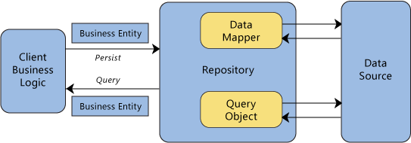
CARE
Repository Pattern
The Repository Pattern will assist in achieving the following objectives:
Provides “the line of demarcation between the application and persistence”. Always use repositories to read/write persistence.
Maximize the amount of code that can be tested with automation and to isolate the data layer to support unit testing.
Access the data source from many locations and want to apply centrally managed, consistent access rules and logic.
Easy to implement and centralize a caching strategy for the data source.
Improve the code's maintainability and readability by separating business logic from persistence logic.
Repository
Provides a clear line of demarcation between application layers. Helpful with respect to unit tests.
Always implement repositories with an interface.
Always consume repositories via an interface.
There can be many classes that implement the repository pattern. They are usually oriented around a domain object that the user will generally understand.
By the conventions contained in this document, “Client Business Logic” is typically contained in Services.
Source, read more.
SettingsManager is the ONLY class that uses the SettingsRepository.
Typically, a repository is consumed by a service, with the service shared to multiple consumers.
In simplified contexts, the repositories can be consumed directly without services.
An example repository
All reads/writes to the disk is through a Repository.
For a given entity, all reads/writes is typically through the same Repository.
Repositories are unit testable.
SettingsManager
SettingsRepository
SettingsRepository is the ONLY class that reads/writes settings to persistence.
A consumer of settingsRepository will always reference a Repository via an interface, the actually implementation can be swapped out,. Irepository, the implementation can change.

Slide 11
CARE
Directory Structure - LIFT
Do make locating our code intuitive, simple and fast.
Why? We find this to be super important for a project. If we cannot find the files we need to work on quickly, we will not be able to work as efficiently as possible, and the structure will need to change. We may not know the file name or where its related files are, so putting them in the most intuitive locations and near each other saves a ton of time. A descriptive folder structure can help with this.
LIFT
L – Locate code quickly.
I – Identify the code at a glance.
F – Keep the flattest, reasonable structure.
T – Try to be DRY
Why:
LIFT Provides a consistent structure that scales well, is modular, and makes it easier to increase developer efficiency by finding code quickly. Another way to check our app structure is to ask ourselves: How quickly can we open and work in all of the related files for a feature?
Do name the file such that we instantly know what it contains and represents.
Do be descriptive with file names and keep the contents of the file to be a single responsibility.
Avoid files with multiple classes, multiple services, multiple types, or a mixture.
Why? We spend less time hunting and pecking for code, and become more efficient. If this means we want longer file names, then so be it.
Do be DRY (Don't Repeat Yourself)
Avoid being so DRY that we sacrifice readability.
Why? Being DRY is important, but not crucial if it sacrifices the others in LIFT, which is why we call it T-DRY.
Attribution

Slide 12
MIT License
Copyright (c) 2017 OldProgrammer.io. Permission is hereby granted, free of charge, to any person obtaining a copy of this software and associated documentation files (the "Software"), to deal in the Software without restriction, including without limitation the rights to use, copy, modify, merge, publish, distribute, sublicense, and/or sell copies of the Software, and to permit persons to whom the Software is furnished to do so, subject to the following conditions: The above copyright notice and this permission notice shall be included in all copies or substantial portions of the Software. THE SOFTWARE IS PROVIDED "AS IS", WITHOUT WARRANTY OF ANY KIND, EXPRESS OR IMPLIED, INCLUDING BUT NOT LIMITED TO THE WARRANTIES OF MERCHANTABILITY, FITNESS FOR A PARTICULAR PURPOSE AND NONINFRINGEMENT. IN NO EVENT SHALL THE AUTHORS OR COPYRIGHT HOLDERS BE LIABLE FOR ANY CLAIM, DAMAGES OR OTHER LIABILITY, WHETHER IN AN ACTION OF CONTRACT, TORT OR OTHERWISE, ARISING FROM, OUT OF OR IN CONNECTION WITH THE SOFTWARE OR THE USE OR OTHER DEALINGS IN THE SOFTWARE.
Jeff@OldProgrammer.io
OldProgrammer.io, LLC
120 East Main Street, #148
Ramsey, NJ 07446

